Slide 1
Crop production prediction
Rumana Palkar

Slide 2
Problem statement
This project aims to predict crop yield in a given region based on historical data, climatic conditions, soil characteristics to build a predictive model that can empower farmers and decision makers with valuable insights for better crop management.

Slide 3
Flow of Project
1.Data Collection
2. Data Preprocessing
3. Model Selection
4. Model Training
5. Model Evaluation
6.EDA
7.Model after EDA
8.Feature Selection
9.Model After Feature Selection
10.Conclusion

Slide 4
Base model
 | model name | r2 | ar2 | mse
0 | linear | 0.014375 | 0.014239 | 126.014928
1 | Lasso | 0.012684 | 0.012548 | 128.078775
2 | Ridge | 0.014375 | 0.014239 | 126.014923
3 | RF | 0.913268 | 0.913256 | 10.902988
4 | XGB | 0.950772 | 0.950765 | 76.430115

Slide 5
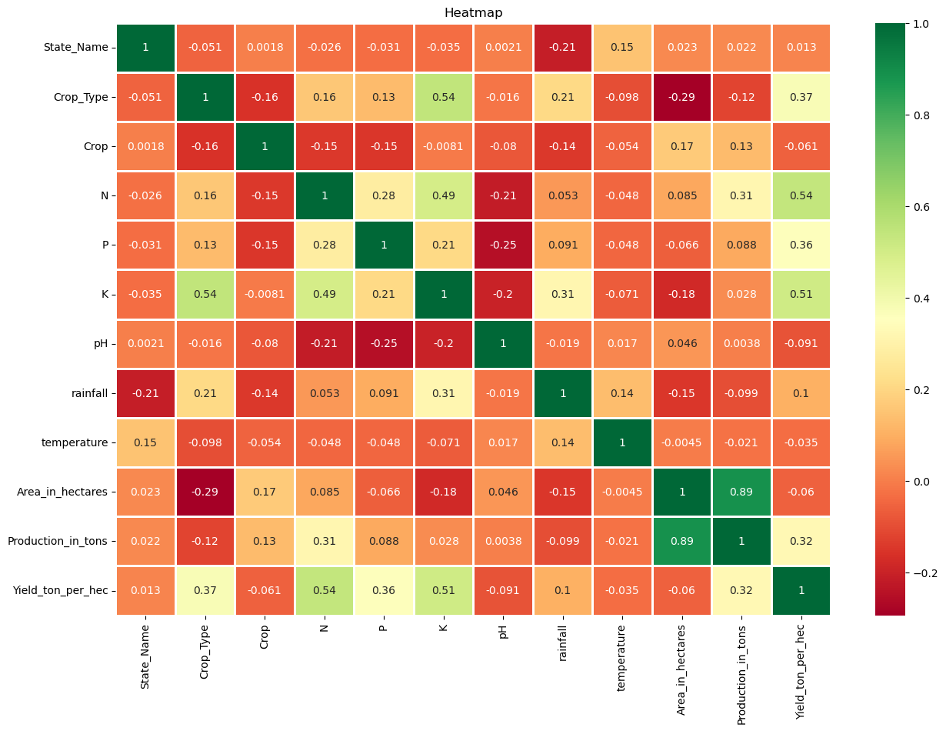

Slide 6
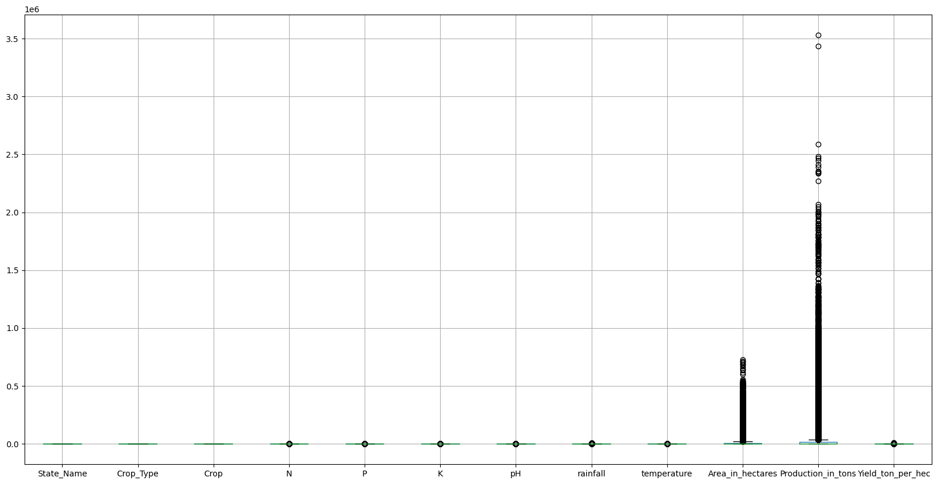
Outlier Treatment

Slide 7
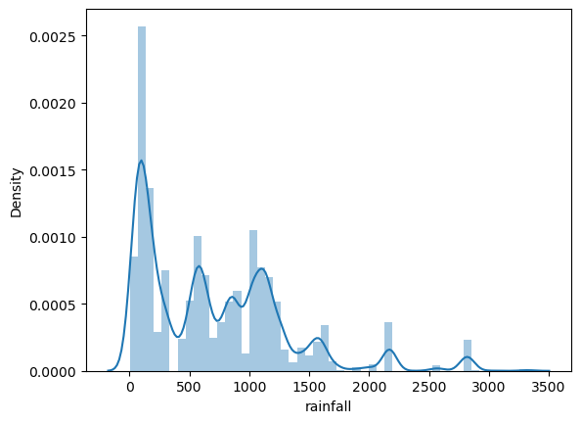
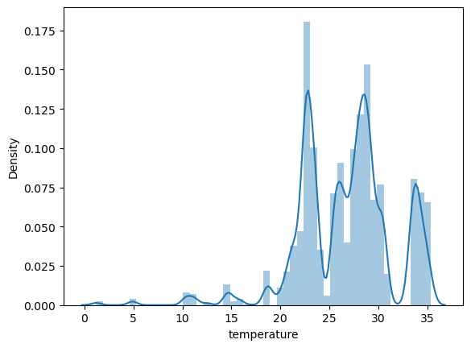
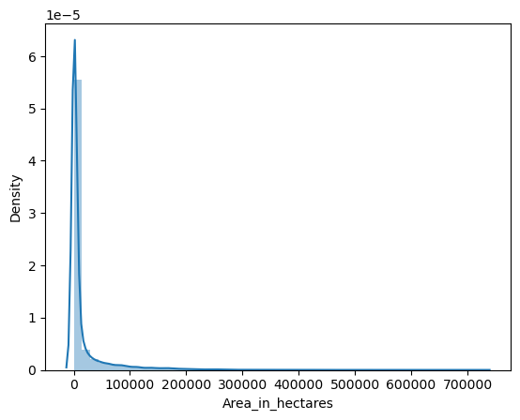
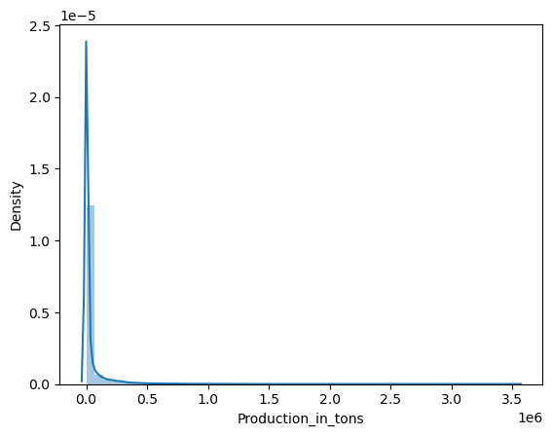
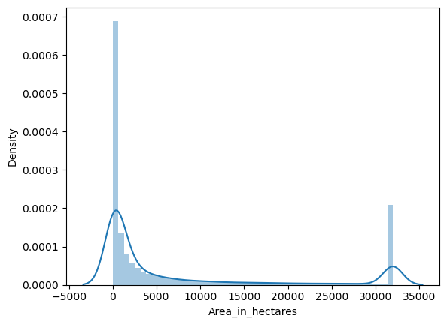
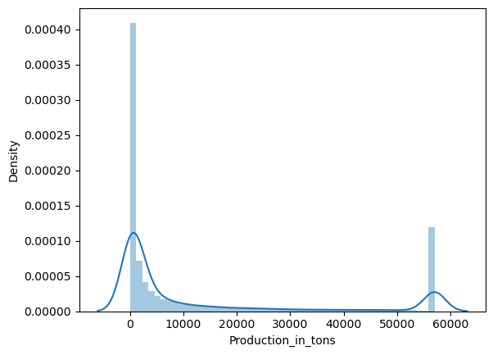
Outlier Treatment impact:distplot before vs. after

Slide 8
Model after EDA
 | model name | r2 | ar2 | mse
0 | linear | 0.014375 | 0.014239 | 126.014928
1 | Lasso | 0.012684 | 0.012548 | 128.078775
2 | Ridge | 0.014375 | 0.014239 | 126.014923
3 | RF | 0.913268 | 0.913256 | 10.902988
4 | XGB | 0.950772 | 0.950765 | 76.430115

Slide 9
Model after feature selection
model name | r2 | ar2 | mse
0 | linear | 0.014375 | 0.014239 | 126.014928
1 | Lasso | 0.012684 | 0.012548 | 128.078775
2 | Ridge | 0.014375 | 0.014239 | 126.014923
3 | RF | 0.913268 | 0.913256 | 10.902988
4 | XGB | 0.950772 | 0.950765 | 76.430115

Slide 10
Comparison of all models
model name | r2 | ar2 | mse
0 | linear1 | 0.014375 | 0.014239 | 126.014928
1 | Lasso1 | 0.012684 | 0.012548 | 128.078775
2 | Ridge1 | 0.014375 | 0.014239 | 126.014923
3 | RF1 | 0.913268 | 0.913256 | 10.902988
4 | XGB1 | 0.950772 | 0.950765 | 76.430115
5
6 | linear2 | 0.72172 | 0.721681 | 0.10759
7 | Lasso2 | 0.311287 | 0.721681 | 0.10759
8 | Ridge2 | 0.72172 | 0.014239 | 0.10759
9 | RF2 | 0.993308 | 0.993307 | 0.007135
10 | XGB2 | 0.826823 | 0.826799 | 0.070317
11
12 | linear3 | 0.27571 | 0.275611 | 0.288031
13 | Lasso3 | 0.088559 | 0.088513 | 0.370992
14 | Ridge3 | 0.27571 | 0.275674 | 0.27571
15 | RF3 | 0.972123 | 0.972119 | 96.431927
16 | XGB3 | 0.661039 | 0.826799 | 0.135795

Slide 11
Conclusion
Linear regression, Lasso, and Ridge regression yielded lower predictive accuracy compared to Random Forest and xgboost algorithems.
The choice of algorithm depends on the specific goals of the crop yield prediction task.
If the primary objective is accurate prediction, Random Forest is a strong choice.
If interpretability is more critical, linear models like Lasso and Ridge are preferable.

Slide 12
Drawback
Data Quality and Availability: Crop yield prediction models heavily rely on high-quality and historical data, including weather data, soil quality, and pest information. In some regions, data may be sparse or of poor quality, which can lead to inaccurate predictions.
Model Interpretability: While some models may offer high predictive accuracy, they can lack interpretability. Understanding why a model makes specific predictions can be difficult, which may limit trust and adoption by farmers and stakeholders.
Overfitting: Overfitting occurs when a model performs well on training data but poorly on unseen data. This is a common issue, especially with complex models, and it can lead to unreliable predictions.
Scalability: Scaling crop yield prediction models for large agricultural areas can be a logistical challenge. The model's performance at a smaller scale might not directly translate to larger regions.

Slide 13
Thank You

